Slide 1


Data Analysis Presentation
by
ZOE B.
A Data /Business Intelligence Analyst with over 10 years of strong experience in performing analysis reporting, creating, and maintaining data migration design documentation, risk assessing, data mining, developing logical data models, and implementing data integration solutions across various industries.
Presentation Covers My Recent Job Experience
To showcase my skills and experience as a Data Analyst, and explain how I can contribute to the success and growth of your organization.

Slide 2

Introduction
1
Experienced Analyst
A Data /Business Intelligence Analyst with over 10 years of strong experience in performing analysis reporting, creating, and maintaining data migration design documentation, risk assessing, data mining, developing logical data models, and implementing data integration solutions across various industries.
2
Recent Job Experience
Presentation Covers My Recent Job Experience
3
Showcase Skills
To showcase my skills and experience as a Data Analyst, and explain how I can contribute to the success and growth of your organization.

Slide 3









Contents
Introduction
Importance of Data Analysis
Data Analysis Process & Tools
Data Collection
Overview of the presentation
Methods and sources of data collection
Why data analysis matters?
Steps involved in data analysis
Data Cleaning and Preparation & Testing
Data Analysis and Visualisations
Examples of My Work
Qualifications/Skills
Extracting insights and creating visual representations
Showcasing personal projects
Highlighting relevant expertise
Ensuring data quality and consistency
Questions and Answers
Addressing audience queries

Slide 4

Why Data Analysis?
1
Meaningful Impact
The ability to make a meaningful impact
2
Extensive Experience
Over 10 years experience in Data Analysis
3
Data-Driven Decision Making
Facilitated data-driven decision-making
4
Diverse Projects
Worked on various data Projects

Slide 5
Data Analysis Process
1
Data Collection
I gathered data from reliable primary and secondary sources to ensure its relevance to business objectives.
2
Data Cleaning
I removed duplicates, corrected errors, and handled missing values, standardizing data formats for consistency.
3
Data Validation
I cross-checked data for accuracy and completeness, validating it against source systems and business rules.
4
Data Modeling
I developed both logical and physical data models, defining relationships and dependencies within the data.
5
Data Analysis
I employed statistical techniques and tools such as SQL, Python, and Power BI to identify trends, patterns, and correlations.

Slide 6
Data Analysis Tools & Techniques
Excel
SQL
Python
Power BI & Tableau
I used Excel to perform basic data analysis, create pivot tables, and develop visualizations for clear insights.
I queried databases, performed data extraction, and conducted complex joins to retrieve and integrate data.
I utilized libraries like Pandas and NumPy for data manipulation and statistical analysis, and automated data processing tasks with scripts.
I created interactive dashboards and visualizations in Power BI and Tableau to provide insightful reporting and support data-driven decision-making.

Slide 7
Data Collection
Data Collection Methods
Challenges in Data Collection
Data Sources: I extracted data from databases and other relevant sources to ensure comprehensive data collection.
Data Inconsistencies:
Solution: I developed standardized data cleaning processes to ensure uniformity across datasets.
Methodology: I combined and cleaned data from various sources to ensure its accuracy and completeness.
Missing Data:
Solution: I implemented imputation techniques and cross-verified missing data with secondary sources to fill gaps.

Slide 8

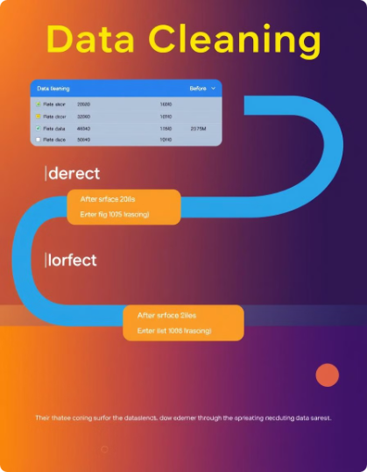
Data Cleaning and Preparation
Data Cleaning
Data Validation
I tackled duplicates, corrected errors, and addressed missing values to ensure high-quality data. Standardized formats and worked to maintain consistency across all datasets.
Cross-checked data with source systems and business rules to verify its accuracy.
Data Preparation
Handling Missing Data
Organized the data into structured formats that were ready for analysis. Developing new metrics and variables, helped me to provide deeper insights and enhance the overall analysis.
Used statistical methods to estimate and replace missing values. Cross-checked with secondary data sources to fill gaps. Excluded non-critical records with excessive missing data. Employing algorithms to predict and fill in missing data based on existing patterns was very helpful.

Slide 9





Data Testing
Ensures data accuracy
Improves data quality
Reduces risks
Saves time and resources
Minimizes the risk of using incorrect data
Data testing verifies the correctness of data
Testing enhances overall data quality
Prevents issues caused by bad data

Slide 10
Data Analysis and Visualisation
Analysis
Visualisation
Tools
I translated insights from the datasets into actionable recommendations, providing clear guidance to support strategic decision-making and improve business outcomes.
I created various types of charts, such as bar charts, line graphs, and pie charts, to represent data trends and comparisons clearly, as well as I designed interactive dashboards using Power BI and Tableau, enabling dynamic data exploration and real-time updates for comprehensive reporting.
SQL
Tableau
Power BI
Excel

Slide 11
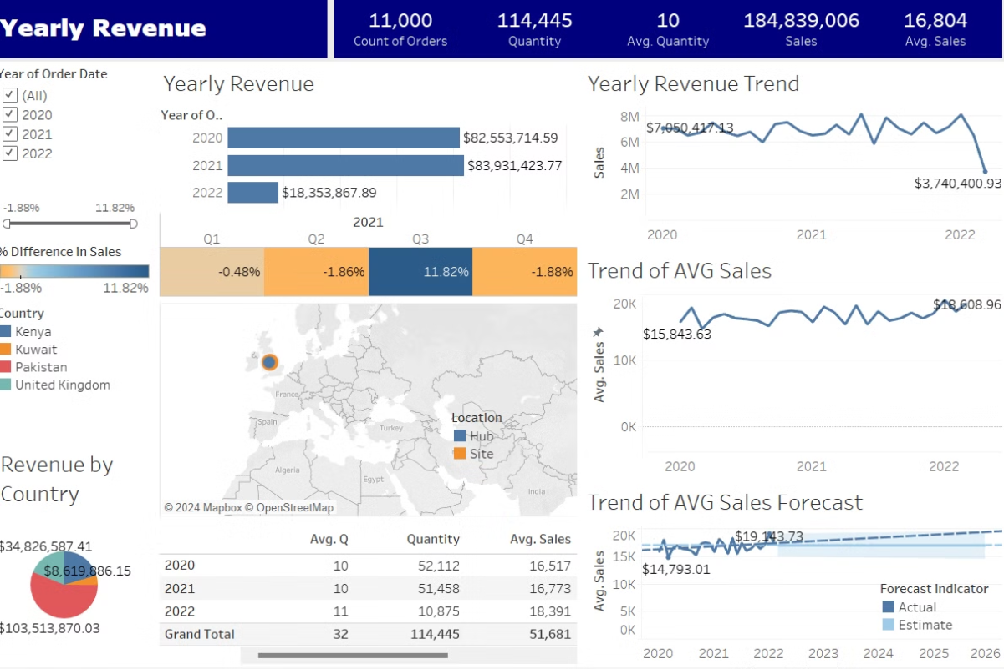
Example of Tableau BI Visual​

Slide 12
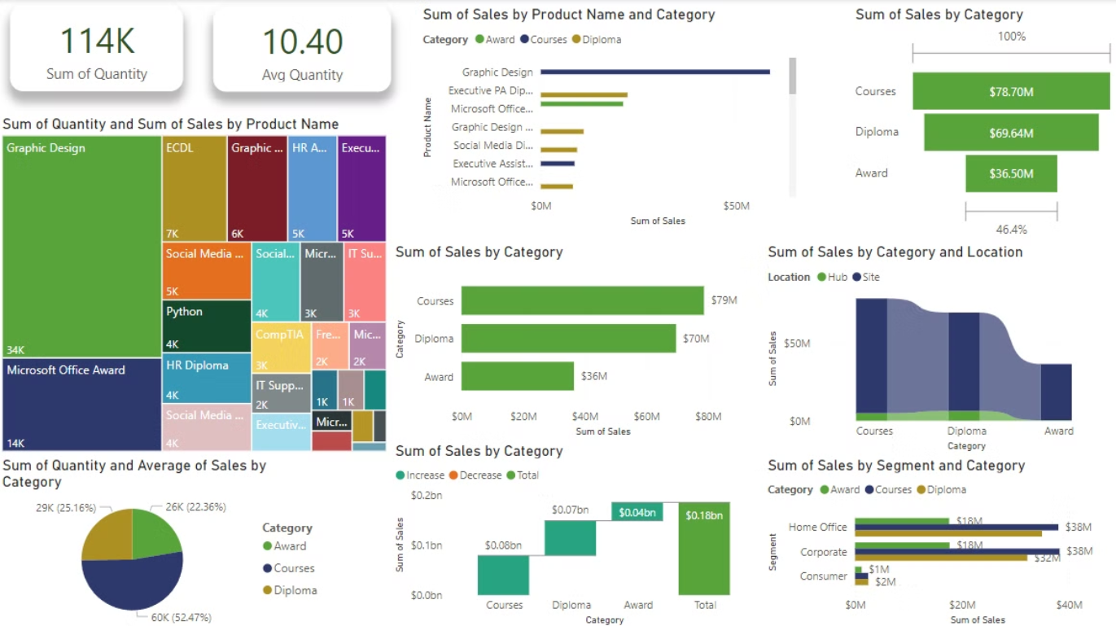
Example of Power BI Visual​

Slide 13

Data Interpretation and Reporting
1
Pattern Analysis
I examined data patterns and correlations to understand the underlying trends and behaviors
2
Detailed Reporting
I prepared detailed reports and presentations, using clear visualizations to convey complex information. I also provided executive summaries to highlight key insights and recommendations
3
Stakeholder Communication
I tailored my communication to different stakeholders, including senior managers and department heads, ensuring that the findings were relevant and actionable for their specific needs.

Slide 14
THANK YOU!
Questions?

